Slide 1
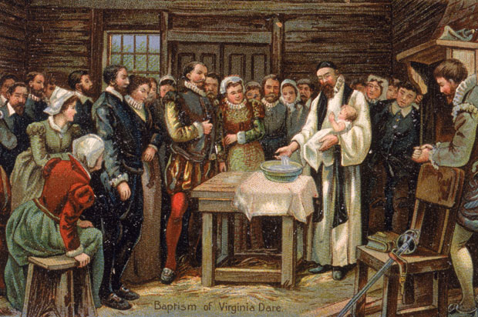
The Lost Colony of Roanoke

Slide 2
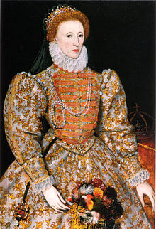
It was 1587….
…and Queen Elizabeth I of England wanted to start a colony in the New World.
So 115 English settlers made the journey to Roanoke Island, in present day North Carolina.

Slide 3
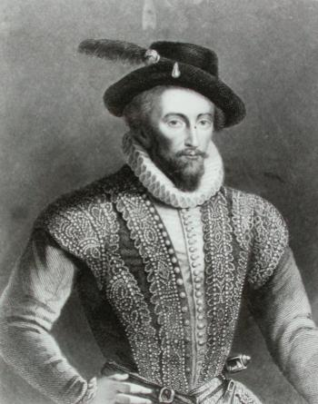
More supplies are needed.
Later that year, the Governor of the new colony, John White, travelled back to England to pick up supplies.

Slide 4
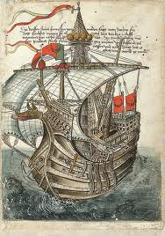
But just as he arrived back in England, a war broke out between England and Spain, and Elizabeth I used every ship to fight against the mighty Spanish Armada (Armada means “lots of ships”)

Slide 5
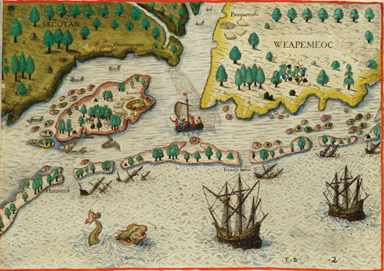
The Return
It wasn’t until three years later, in 1580, that John White returned to Roanoke Island.
He had left his wife, his daughter and his infant granddaughter behind on Roanoke Island.

Slide 6
When he returned, there was no trace of the colony – the inhabitants of Roanoke had disappeared.
Except for bones and ……

Slide 7
….a single word carved into a piece of wood.
CROATOAN
What happened to the colony at Roanoke?

Slide 8
Theories
The Croatoans were a tribe of American Indians that lived south of Roanoke. Do you think the settlers joined them?
Maybe the colonists sailed back to England. Could they have been captured by the Spanish? Or maybe lost at sea?
Perhaps they moved inland. Never to be heard from again….

Slide 9
The Roanoke Mystery
Nobody really knows what happened to the Lost Colony at Roanoke….it’s still a mystery.
Mystery at Roanoke — History.com Video

Slide 10
Have we found the lost colony of Roanoke?
https://www.youtube.com/watch?v=ofhIJ1wMKtc

