Slide 1
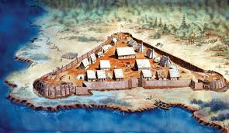
Jamestown
(or let’s try this colony thing again)

Slide 2
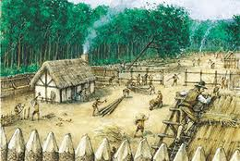
So after Roanoke’s not very successful attempt at being a colony, King James I of England decides to try again (he really needed the money from the New World!)
In 1606, he gave permission for two companies to start new colonies in the New World – or present-day Virginia.
One colony was Jamestown, and was named after King James I.

Slide 3
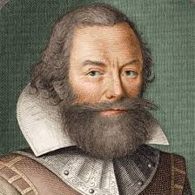
Not the best place…
When the colonists arrived at the James River, they picked a spot they liked.
John Smith called the spot, “a very fit place for erecting a great city.”
It wasn’t. It was swampy and mosquito infested, and the river water was foul. YUCK!

Slide 4
http://www.history.com/topics/jamestown/videos

Slide 5
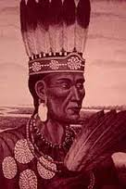
Life in Jamestown
Life was tough – the settlement almost died out several times.
But thanks to Captain John Smith and his leadership, the colony started to flourish and do well.
Captain Smith began trading with Chief Powhatan, leader of the Powhatan people and for a brief time, relations between the English settlers and the Powhatan was peaceful.
Chief Powhatan’s daughter was named Pocahantas. Yep, that Pocahantas…

Slide 6
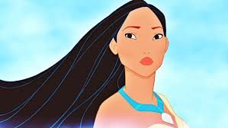
Pocahontas: Fiction
Modern fictional pictures of Pocahontas has her looking like this:

Slide 7
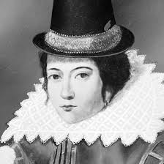
Pocahontas: Fact
When in reality she looked like this:

Slide 8
Smith & Pocahontas
Captain Smith gets captured by the Powhatan Indians and he is almost killed by them.
Pocahontas pleads for Captain Smith’s life, and Chief Powhatan allows Smith to return to his colony.
The relationship between the Powhatan Indians and the people of Jamestown continues, with the Indians teaching the colonists about hunting, fishing, and planting crops.

Slide 9
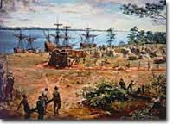
Smith Returns to England
Captain Smith is hurt and returns to England, and the colony starts to fail.
The “Starving Time” occurs. Over 500 settlers die because of lack of food. Only 60 people are left at the end of the winter of 1608.

Slide 10
Tobacco saves Jamestown
There wasn’t any gold in Jamestown, but the land was perfect for growing tobacco.
In 1612, John Rolfe raised a crop of tobacco and it became Virginia’s first cash crop.
King James I hated tobacco – he thought it was unhealthy.
John Rolfe and Pocahontas get married and travel to England. But Pocahontas gets sick with pneumonia and dies.

Slide 11
As Jamestown grows into a successful trade port, they develop a system of government called “The House of Burgesses”. This was the first law-making assembly in an English colony.
But things start heading south…there is some trouble with the American Indians, tobacco prices fall and the settlement get hit with some pretty nasty diseases.

